Slide 1

NASA Electronic Parts and Packaging (NEPP) Program
Stress Testing of Chip Aluminum Polymer Capacitors
Jay Brusse, NASA/SSAI
Alexander Teverovsky, Jacobs Technology Inc.
jay.a.brusse@nasa.gov
alexander.a.teverovsky@nasa.gov

Slide 2
List of Acronyms
AC | alternative current | IM | infant mortality
ACC | anomalous charging current | LF | lead frame
APC | aluminum polymer capacitor | RH | relative humidity
CCS | constant current stress | T | temperature
DC | direct current | TDDB | time dependent dielectric breakdown
DCL | DC leakage | TPC | tantalum polymer capacitor
DF | dissipation factor | TTF | time to failure
ESR | equivalent series resistance | VBR | voltage breakdown
HALT | highly accelerated life testing | VR | voltage rating
HTS | high temperature storage | WO | wear-out
IL | initial limit

Slide 3
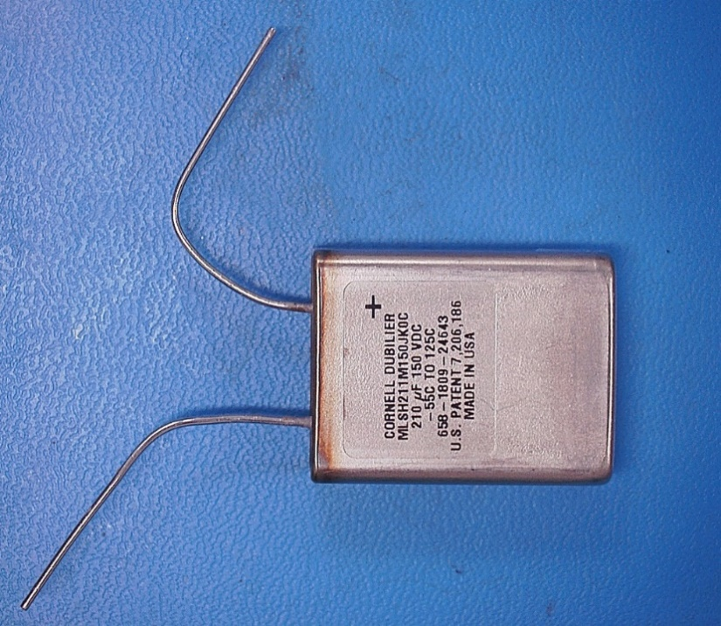
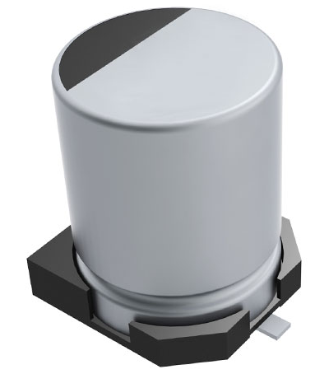
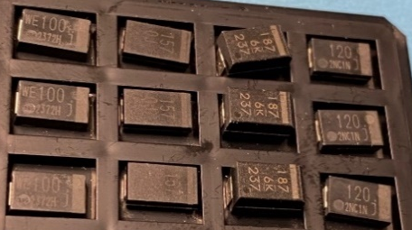
Outline
Aluminum Electrolytic Capacitors
that can be potentially used in space
Hermetically sealed wet
Specifics of chip APCs
Construction analysis
Effect of Hight Temperature Storage (HTS)
Effect of humidity
Highly Accelerated Life Testing (HALT)
Conclusion
Solid or Hybrid
Layered Chips

Slide 4
Benefits and Problems with Aluminum Polymer Capacitors
  Benefits:
    similar footprint and interchangeability with chip tantalum capacitors;
    compared to TPCs, APCs have lower ESR and mass;
    tolerance to reverse bias is better than in tantalum capacitors (?)
  Problems:
    anomalous transients and ACC;
    degradation and failures in humid environments;
    degradation and failures during storage at high temperatures;
    instability of leakage currents due to poor self-healing;
    no history of hi-rel/space applications;
    insufficient data on long-term reliability.
  The purpose of this work is to address reliability risks with APCs and
  to assess the possibility of their use in space applications.

Slide 5
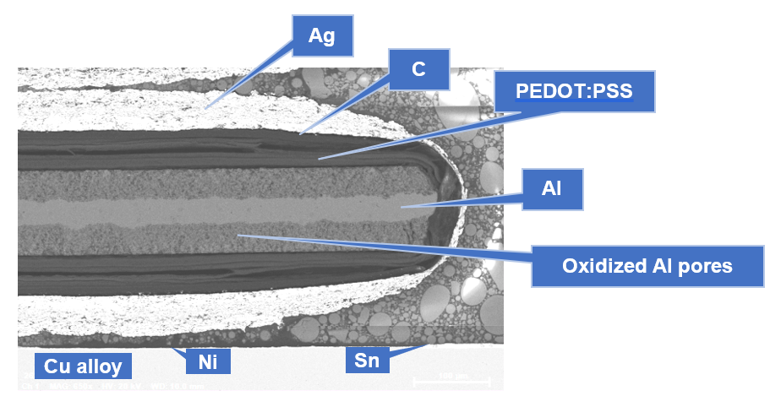
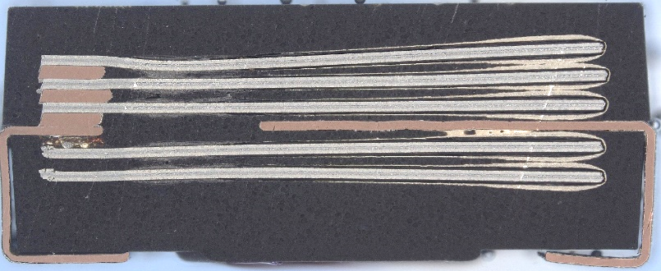
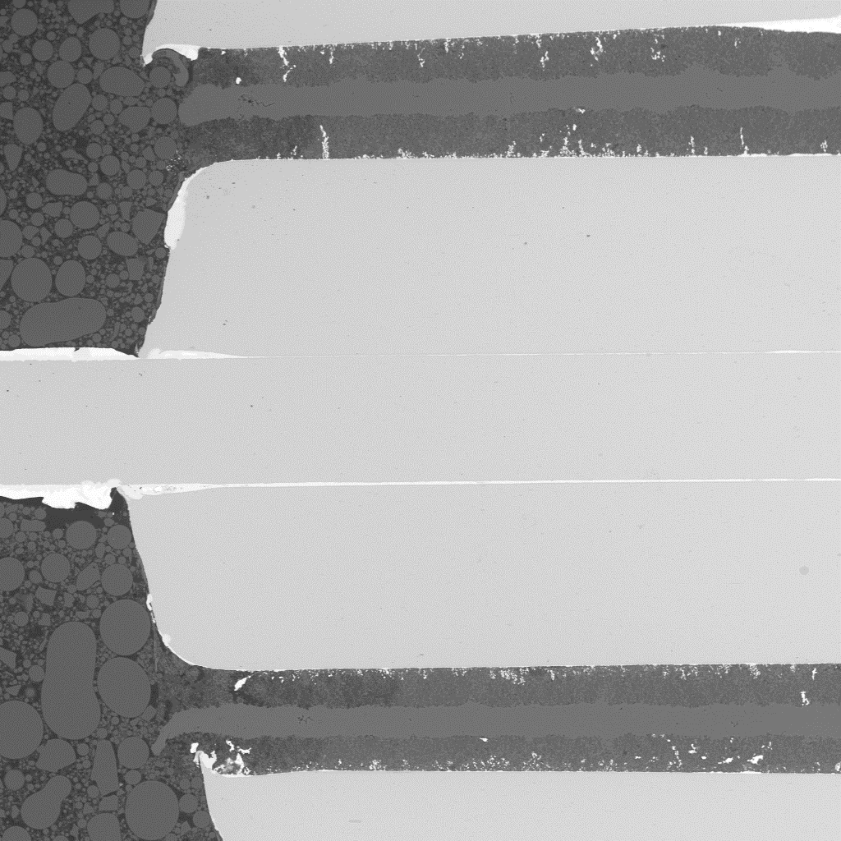
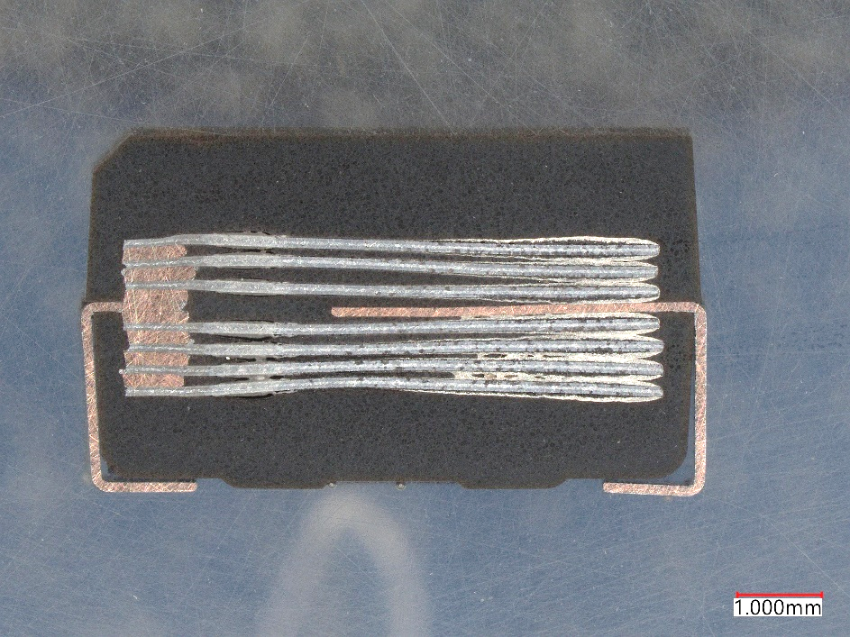
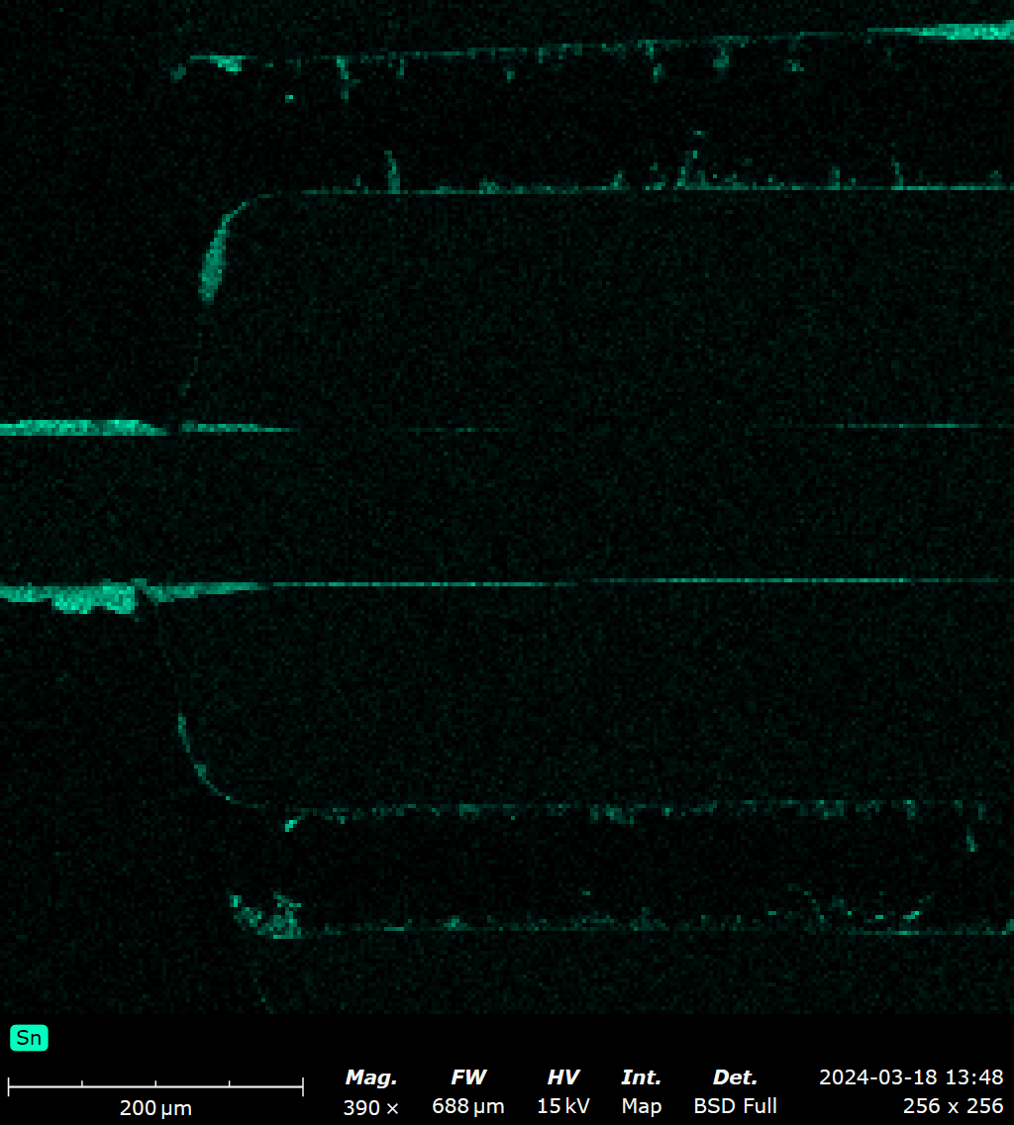
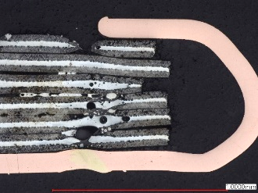
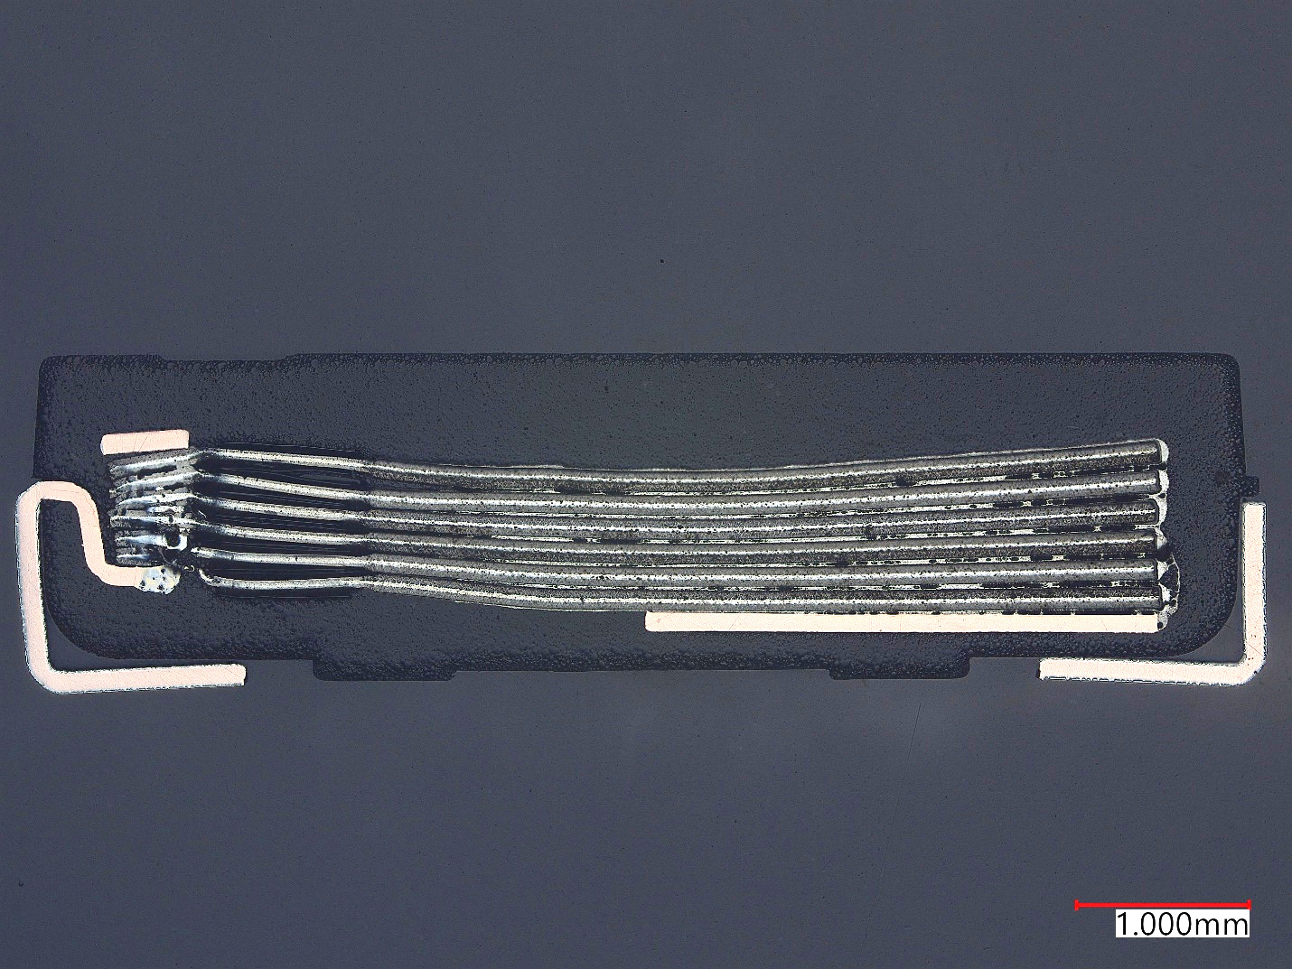
Used Parts and Design
  APCs used in this study
Gr. | Mfr | C, uF | VR, V | ESR, mohm | DF, % | DCL, uA | T_{max}, C | H, mm
1 | A | 120 | 6.3 | 9 | 6 | 75 | 105 | 1.9
2 | B | 180 | 6.3 | 10 | 6 | 45 | 125 | 2.8
3 | C | 150 | 6.3 | 15 | 6 | 94.5 | 105 | 1.9
4 | D | 100 | 6.3 | 15 | 6 | 63 | 105 | 1.9
5 | B | 33 | 10 | 18 | 6 | 13 | 125 | 2
6 | B | 15 | 25 | 40 | 6 | 15 | 125 | 2
7 | B | 15 | 35 | 40 | 6 | 53 | 125 | 2.8
180uF 6.3V
15uF 35V
Sn
  APCs use multilayer Al foil, but
  differ by shape and position of the
  cathode LF, anode construction
  (spacer) and welding.
  Oxide layers at the edges of
  Al plates might differ from oxide
  in the pores.
120uF 6.3V

Slide 6
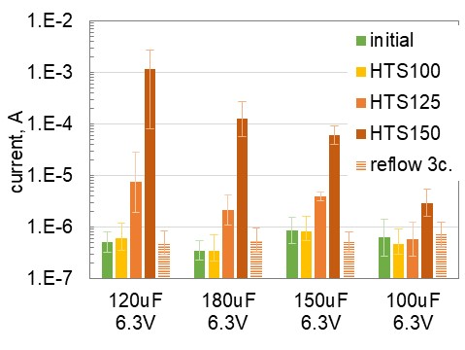
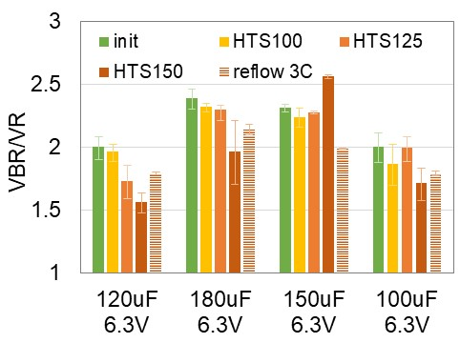
High Temperature Storage
  HTS was carried out at 100C, 125C, and 150C.
  TTF was determined at 10% decrease of capacitance.
Examples of degradation of C and DF
  Behavior of the parts during HTS is similar to PTCs.
  Significant increase of DCL at T > 100C.
  Three cycles of reflow soldering (T_{max}= 235C) did
  not degrade DCL and VBR.
  A tendency of reducing VBR after HTS.
  E_{a} of degradation processes 0.73 ±0.1 eV.
  Extrapolations to 65C indicate TTF from 6 to 48years.

Slide 7
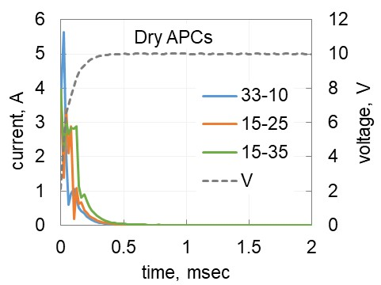
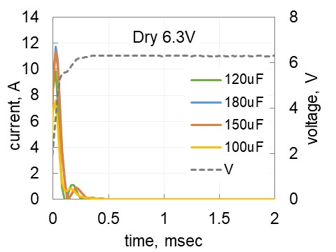
Anomalous Charging Currents
  The level of ACC in APCs was measured using a power surge test.
  The transfer charge, Q_{t}, and dissipated energy, U_{d}, during anomalous charging in PTCs can exceed 0.1 C and 1 J, respectively.
 | experimental |  | calculated
 | Charge, C | energy, J | CV, C | CV², J | charge ratio | energy ratio
33uF 10V | 2.2E-04 | 2.0E-03 | 3.3E-04 | 3.3E-03 | 0.66 | 0.61
15uF 25V | 3.1E-04 | 5.3E-03 | 3.8E-04 | 9.4E-03 | 0.83 | 0.57
15uF 35V | 4.9E-04 | 1.1E-02 | 5.3E-04 | 1.8E-02 | 0.93 | 0.62
120uF 6.3V | 7.1E-04 | 2.6E-03 | 7.6E-04 | 4.8E-03 | 0.94 | 0.55
180uF 6.3V | 1.1E-03 | 4.2E-03 | 1.1E-03 | 7.1E-03 | 0.94 | 0.59
150uF 6.3V | 9.7E-04 | 3.8E-03 | 9.5E-04 | 6.0E-03 | 1.03 | 0.64
100uF 6.3V | 8.5E-04 | 3.4E-03 | 6.3E-04 | 4.0E-03 | 1.36 | 0.85
  Contrary to PTCs, there is no ACC in dry APCs
  initially or after HTS.
  The difference is likely due to different level and
  distributions of traps in anodic Ta2O5 and
  Al2O3 dielectrics.

Slide 8
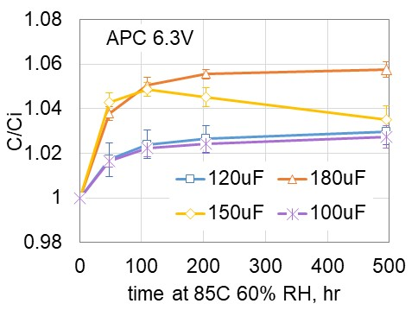
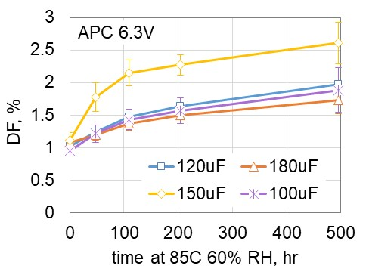
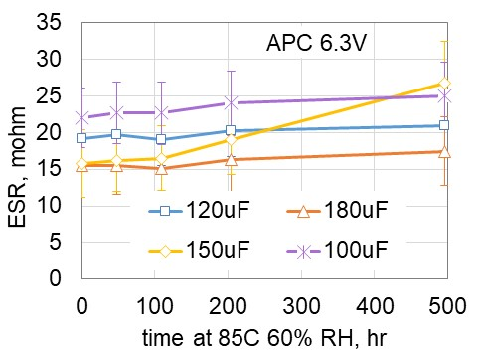
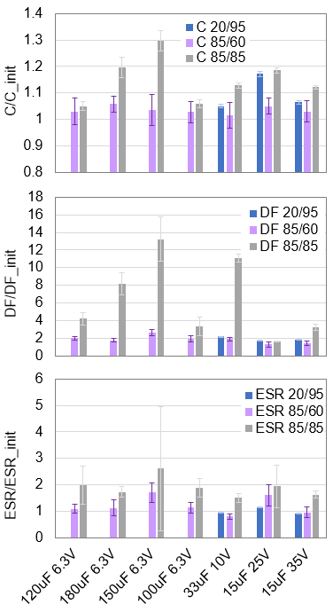
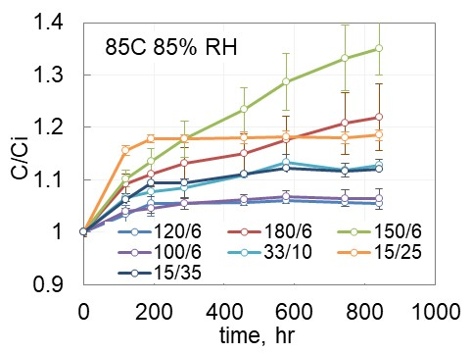
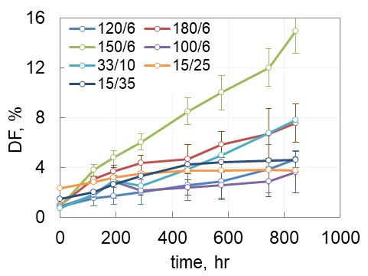
Effect of Humidity on AC Characteristics
  Conditions during storage in humid environments:
  (1) 20C, 95% RH for 1500hr, (2) 85C, 85% RH for 850hr, (3) 85C, 60% RH for 500hr.
  In most cases, parameters are stabilizing after 200 hours of storage at 85C.
  DF had a tendency of gradual increasing and for 3 out of 7 lots exceeded
  the specified values after 85/85 testing.
  Variations of ESR are below 3×IL for all types except 150uF/6.3V.

Slide 9
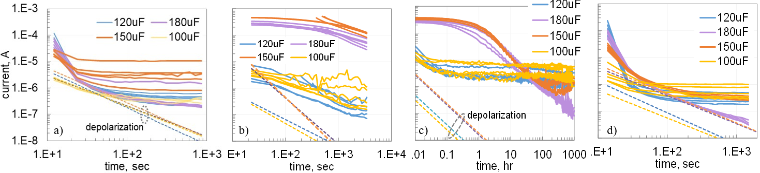
Effect of Humidity on DCL
  Initial After 85/85 Bias at 9V Final
  Moisture degraded DCL in 5 out of 7 types, but
  currents in two lots remained stable.
  Absorption currents after humidity storage increased
  substantially in 2 out of 4 part types indicating
  difference in the structure of oxides.
  Leakage currents decreased with time under bias
  likely due to anodic oxidation.
  All lots passed 85/60 test that is sufficient for space
  applications.

Slide 10
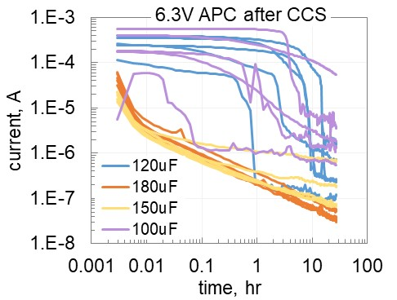
Effect of Humidity on VBR
  VBR was determined by CCS testing after different storage conditions.
  Relaxation of leakage currents was measured after CCS testing.
  Moisture increased VBR in all types of APCs indicating anodic oxidation
  during CCS.
  Capacitors that appeared shorted after CCS reduced leakage currents
  after a few hours under bias suggesting that breakdown is associated with
  increasing of anomalous transients.

Slide 11
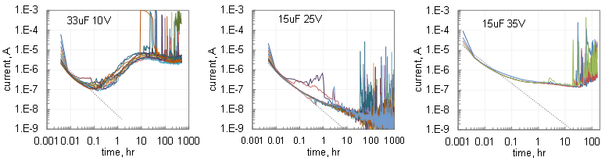
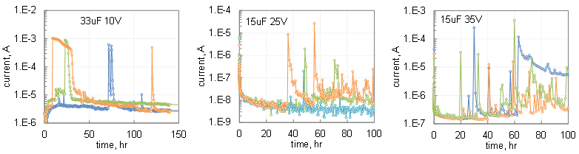
Leakage Currents during HALT
  Currents were monitored at 125C and 1.4VR for 10V capacitors and 1.2VR
  for 25V and 35V capacitors.
Examples of spikes during HALT
  Spiking starts after a certain incubation period.
  Currents increase sharply and decrease during hours under bias.
  The mechanism is likely due to emptying interface states during local
  overheating and a gradual process of the post-scintillation re-trapping.

Slide 12


Highly Accelerated Life Test
  HALT conditions: 85C and voltages up to 1.9VR.
  TDDB:
$$TTF=t_{o}×exp\left[\frac{∆H}{kT}×\left(1−\frac{V}{V_{BR}}\right)\right]$$
$${AF}_{V}=exp\left[B×\left(\frac{V}{VR}−1\right)\right]$$
  Similar to TPCs, APCs have IM and WO failures.
  TTF(V) for WO can be described using a thermochemical TDDB model.
  Voltage acceleration constant B (up to 29) is greater than for TPCs.
  Estimated TTF values at 85C and VR exceed 170 years.
  At voltage derating from 6.3 V to 4 V the useful life exceeds 1000 years.
  Anti-WO failures are due to increasing VBR during HALT.

Slide 13
Conclusions
Similar to tantalum, AC characteristics of aluminum polymer capacitors degrade during HTS in air at E_{a} ~ 0.73 eV. Vacuum conditions will retard the degradation process.
Contrary to tantalum, no anomalous charging currents (ACC) were observed in any of the tested APCs initially or after HTS.
Leakage currents increase substantially after storage in humid environments, but under bias they decrease gradually to the levels below the initial.
HALT at 85C showed that reliability of different types of aluminum capacitors varies substantially, from no failures after 1100 hours at 1.8VR to 90% failures by 30 hours at 1.6VR.
Failures of APCs can be described using an exponential TDDB model with high voltage acceleration constants that varies for different part types from 16 to 29.
Anti-WO failures are due to increasing of VBR in the process of HALT.
Assuring proper storage, handling, screening, lot acceptance testing, and derating, some types of APCs can be used in spaceflight applications.

